Slide 1
Package & Interface
Prepared by
Bal Krishna Subedi
St. Xavier’s College
Prepared by Bal Krishna Subedi

Slide 2
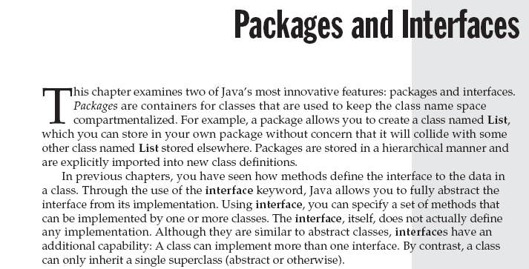
Prepared by Bal Krishna Subedi

Slide 3
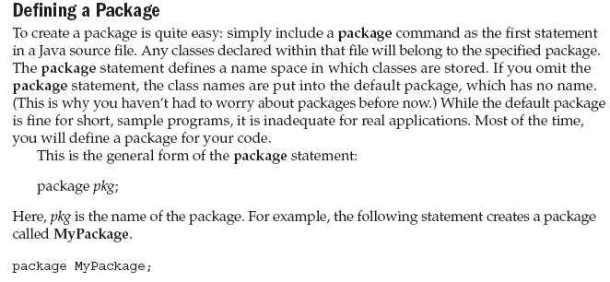
Prepared by Bal Krishna Subedi

Slide 4
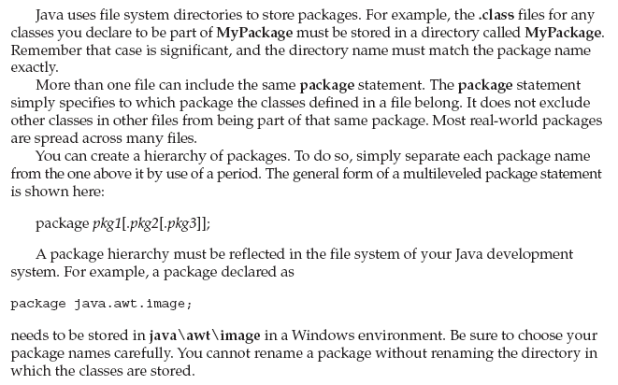
Prepared by Bal Krishna Subedi

Slide 5
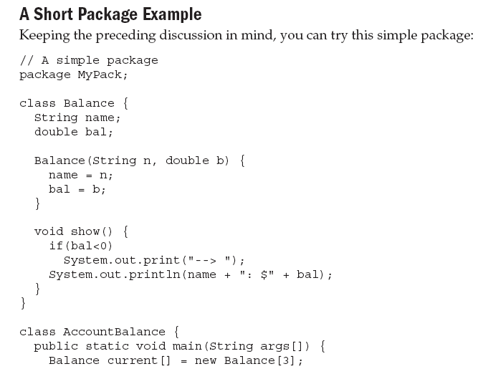
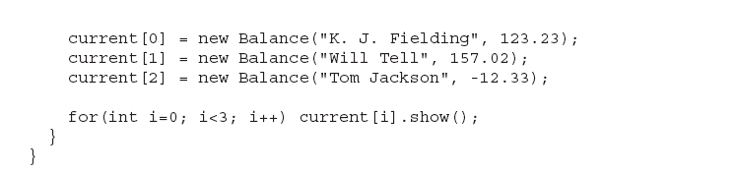
Prepared by Bal Krishna Subedi

Slide 6
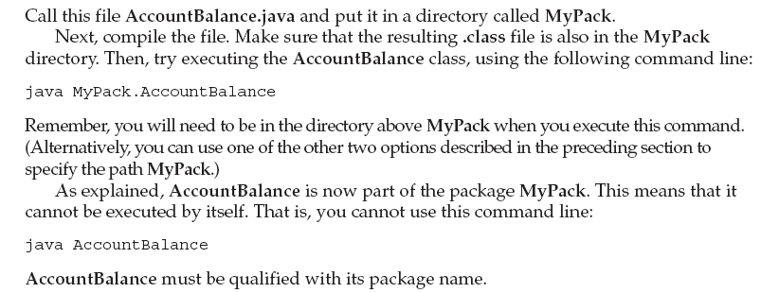
Prepared by Bal Krishna Subedi

Slide 7
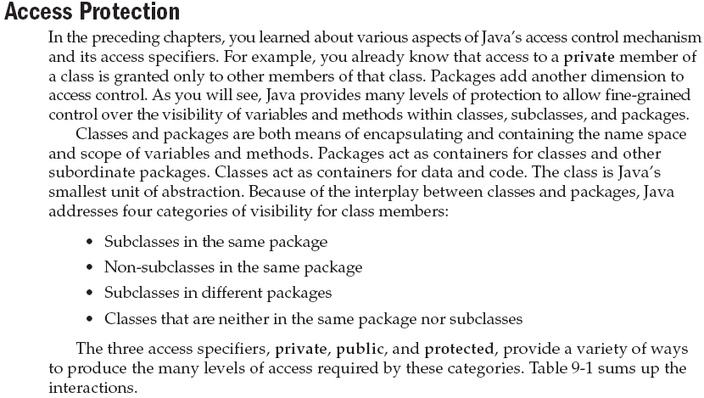
Prepared by Bal Krishna Subedi

Slide 8
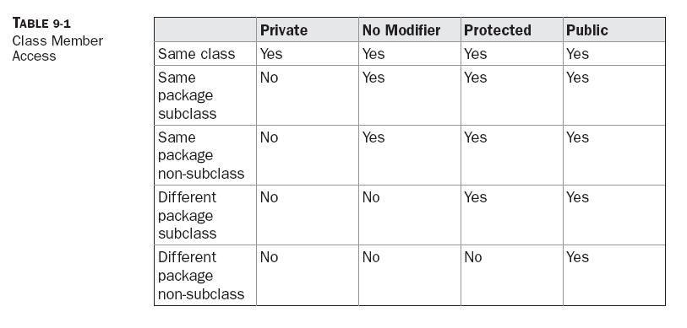
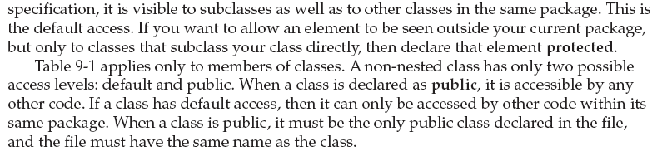
Prepared by Bal Krishna Subedi

Slide 9
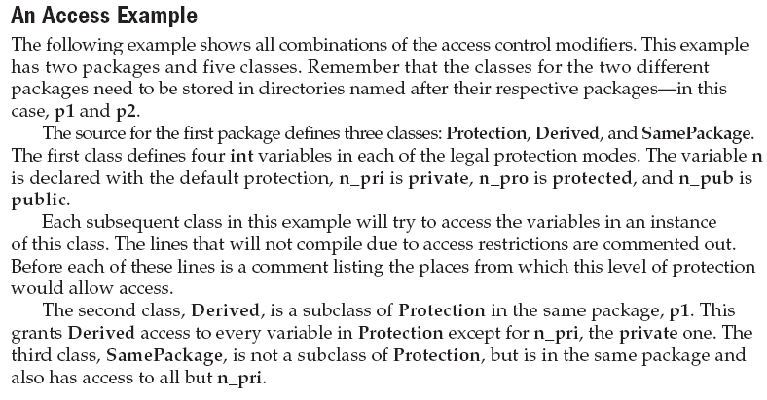
Prepared by Bal Krishna Subedi

Slide 10
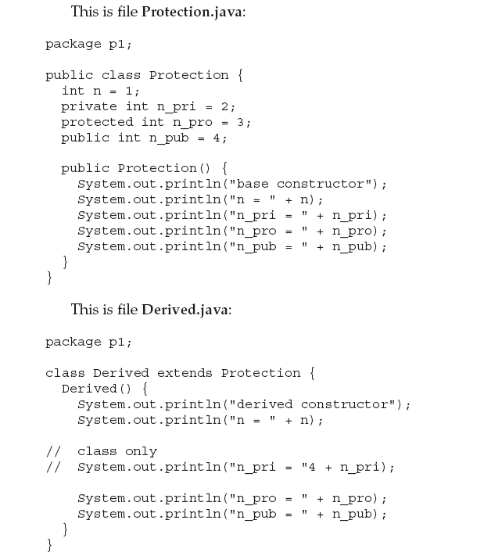
Prepared by Bal Krishna Subedi

Slide 11
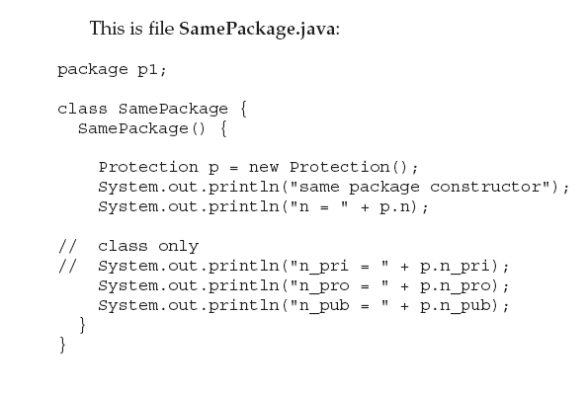
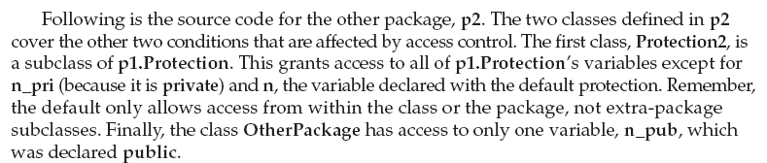
Prepared by Bal Krishna Subedi

Slide 12
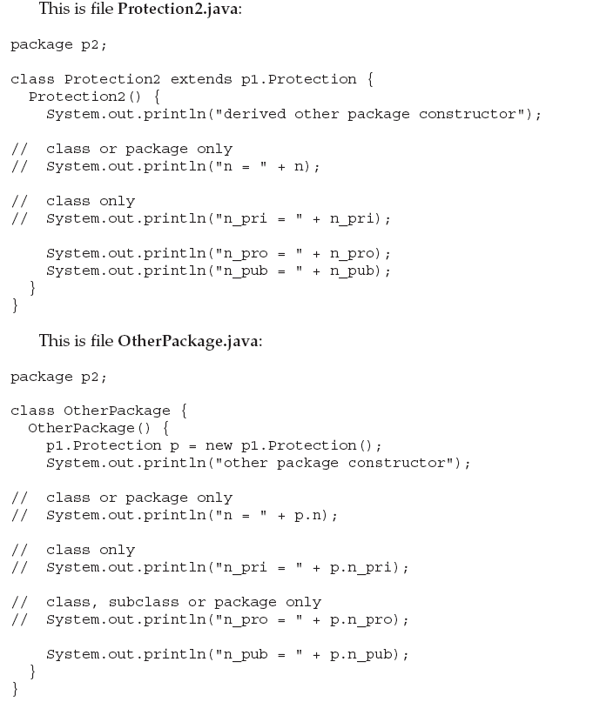
Prepared by Bal Krishna Subedi

Slide 13
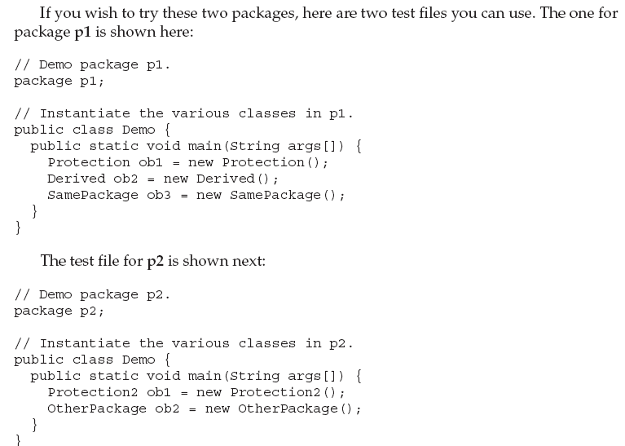
Prepared by Bal Krishna Subedi

Slide 14
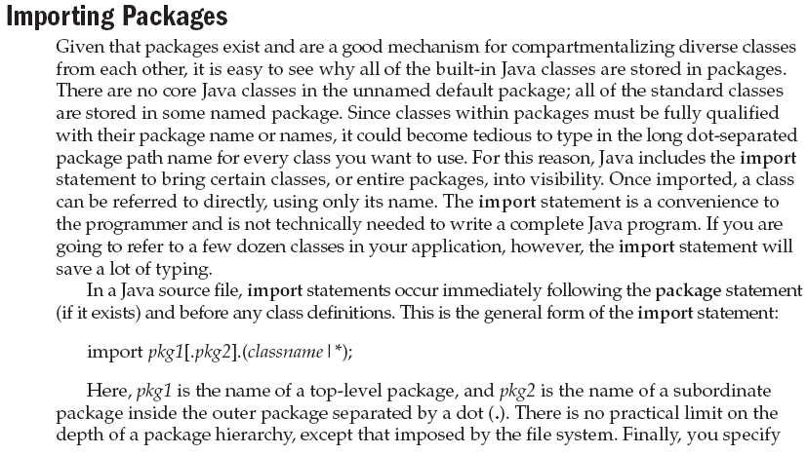
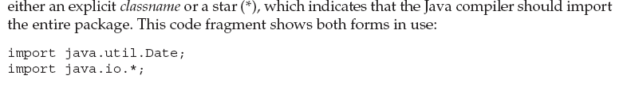
Prepared by Bal Krishna Subedi

Slide 15
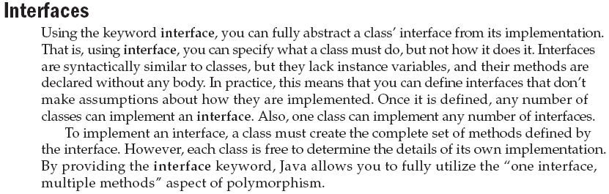
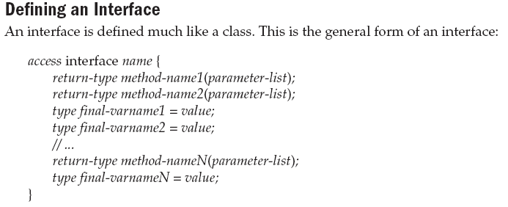
Prepared by Bal Krishna Subedi

Slide 16
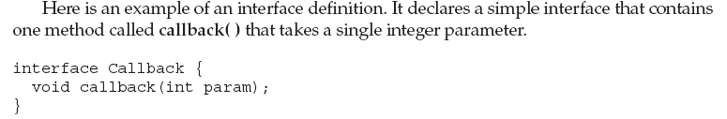
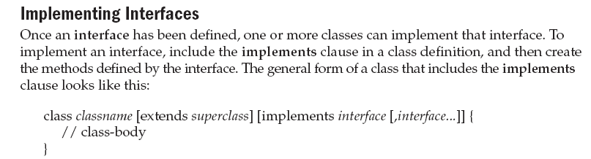
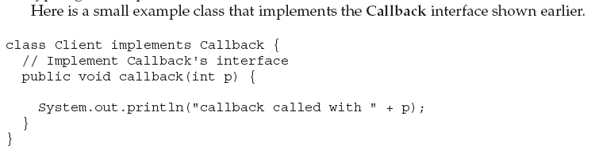

Prepared by Bal Krishna Subedi

Slide 17
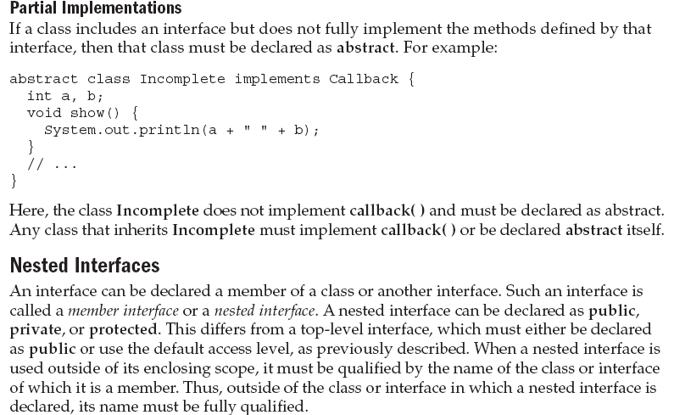
Prepared by Bal Krishna Subedi

Slide 18
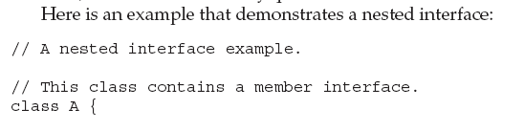
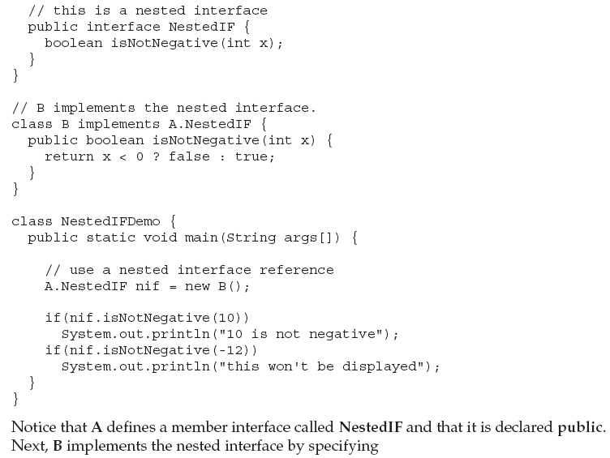
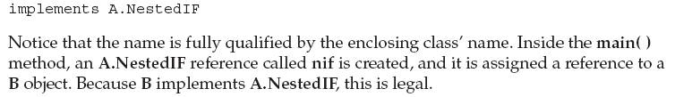
Prepared by Bal Krishna Subedi

Slide 19
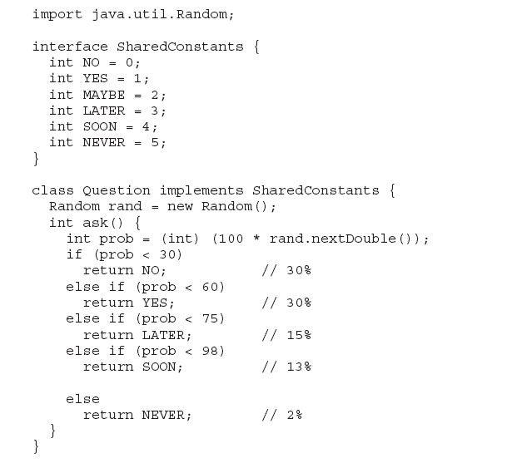
Variables in Interface example
Prepared by Bal Krishna Subedi

Slide 20
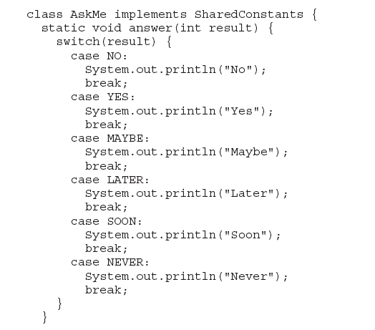
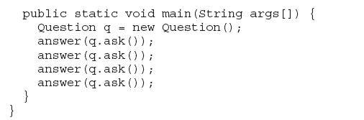
Prepared by Bal Krishna Subedi

Slide 21
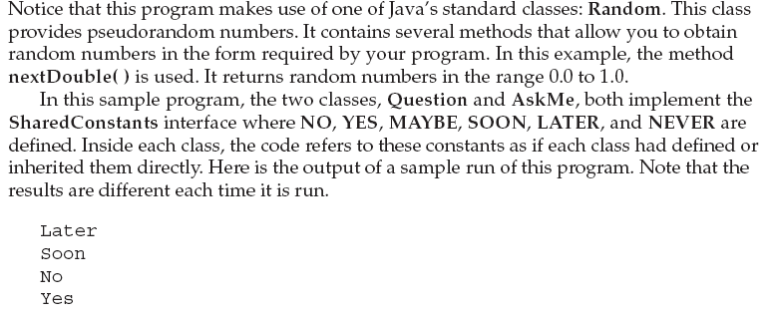
Prepared by Bal Krishna Subedi

Slide 22
Lab Assignment
Write a program to illustrate uses of packages.
Write a program to illustrate uses of interface.
Prepared by Bal Krishna Subedi

